Slide 1



Cloud without Governance is Chaos
Stuff you should know before starting to code
@rikhepworth
github.com/rikhepworth
blogs.blackmarble.co.uk

Slide 2
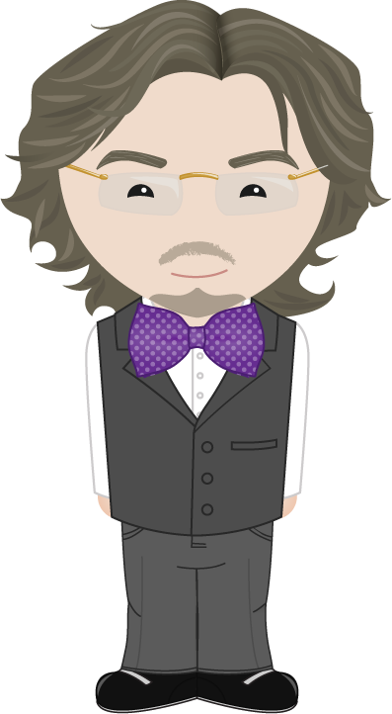

Rik Hepworth
Consulting Services Director, Black Marble
MVP (Azure)
@rikhepworth
github.com/rikhepworth
blogs.blackmarble.co.uk

Slide 3

How adopting cloud should feel
Photo credit: NASA

Slide 4

How adopting cloud usually feels
Image credit: Matt Rudowsky

Slide 5
Let’s start with ways to buy
Enterprise Agreement EA
Cloud Solution Provider CSP
Pay-as-you-go PAYG
Notes:
https://azure.microsoft.com/en-us/pricing/purchase-options/

Slide 6
Subscription types
20% Cheaper
Standard Full SLA
Dev/Test No SLA
Production Ready!
Notes:
https://azure.microsoft.com/en-us/offers/ms-azr-0003p/
https://azure.microsoft.com/en-us/offers/ms-azr-0148p/
https://azure.microsoft.com/en-us/offers/ms-azr-0023p/

Slide 7
Identity
Azure Active Directory
Acts as source of identity for a subscription
Every sub has one, even if you used an MSA
Connect your AAD to your AD
Simple to do using ADConnect
Ensures consistent identity across the organisation
Allows unified role management
Use Role Based Access Control (RBAC) in your subscription
Notes:
https://docs.microsoft.com/en-us/azure/active-directory/

Slide 9
Role Based Access Control
Apply security through AAD groups and identities
Applied to subscription, resource group or resource
Control access and capabilities
Notes:
https://docs.microsoft.com/en-us/azure/active-directory/role-based-access-control-what-is

Slide 10
Azure Policies
Declarative rules for a subscription
Can either block or audit
Limits usage to approved locations or services
Can enforce use of Tags (great for billing)
Notes:
https://docs.microsoft.com/en-us/azure/azure-policy/azure-policy-introduction

Slide 11
Resource Locks
Locks a resource to prevent accidental deletion or modification
Addition protection over RBAC
Notes:
https://docs.microsoft.com/en-us/azure/azure-resource-manager/resource-group-lock-resources

Slide 12
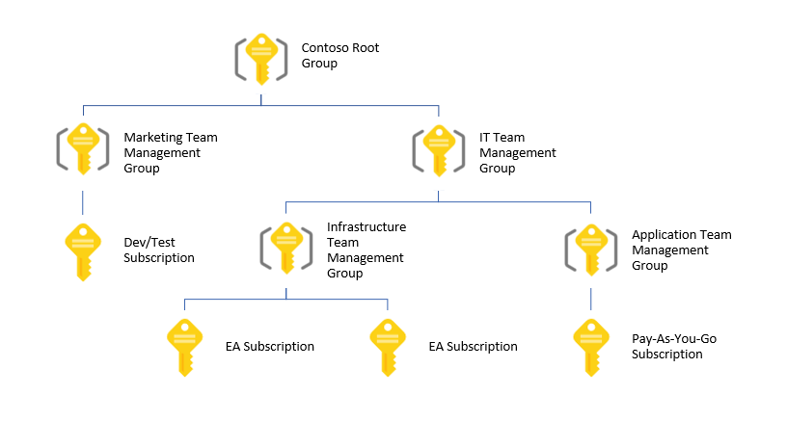
Azure Management Groups
Notes:
https://docs.microsoft.com/en-us/azure/azure-resource-manager/management-groups-overview

Slide 13
Azure Monitor
Provides access to event auditing in Azure subscriptions
View telemetry emitted by Azure services
Notes:
https://docs.microsoft.com/en-us/azure/monitoring-and-diagnostics/monitoring-get-started

Slide 14
In Summary
Governance is important. ‘Rules of engagement’ save us from ourselves
Developers are often pioneers of cloud We demand best practice in our solutions so why not in our cloud usage? Show your organisation the way!
Azure has a rich array of tools to help apply and manage governance

Slide 15
Useful Links
Microsoft Azure Docs https://docs.microsoft.com/en-us/azure/
@rikhepworth
github.com/rikhepworth
blogs.blackmarble.co.uk

